Slide 1
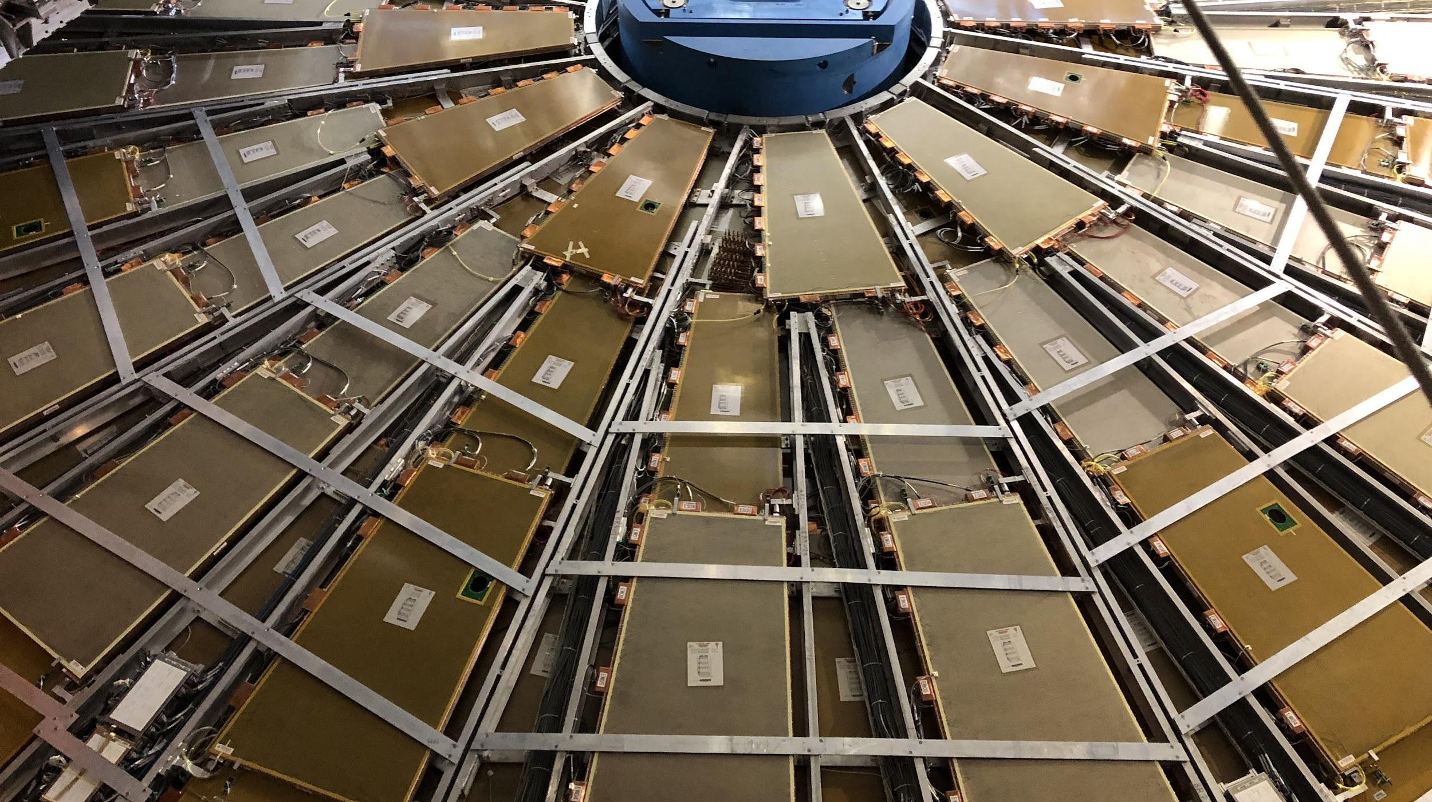


CIS Tech Update
Chicago Meeting, February 6th, 2023
Peter Camporeale and Jacky Li

Slide 2
Outline
Since Oct. 31th, 2022…
Normal CIS Constant Updates
October 1 - November 1
End-of-Year Recalibration/Reprocessing
Procedure
Run 3 (March - November) results with Preliminary Public Plots
L1Calo PMT Scans
Maintenance Progress
General Status
Cooling
Plans for Next Quarter

Slide 3
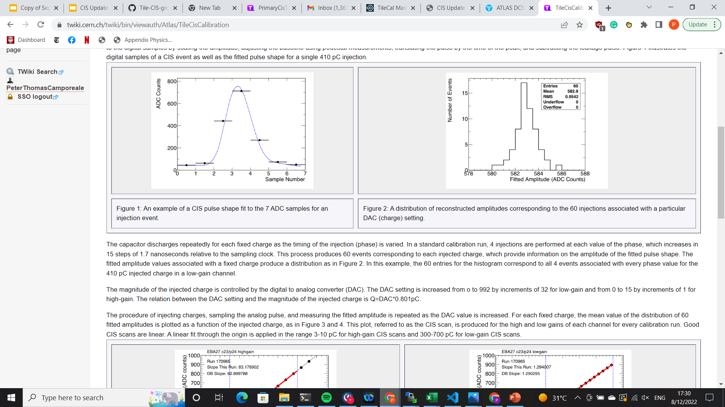
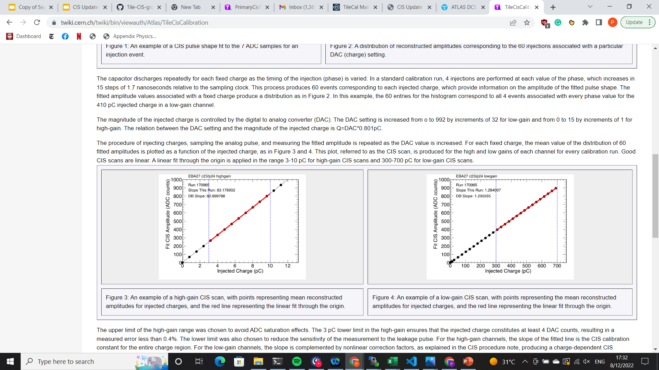
1.a. Introduction of CIS
Use known input charge to calibrate ADC counts of front-end electronics
3-in-1 cards contain 5,100 pF capacitors
Input known charge 60 times, sample each pulse 7 times 🡪 pulse amplitude
Fit mean pulse amplitude (in ADC counts) to injected charge
CIS calibration runs are taken between ATLAS runs, roughly 3 times per week
Use TUCS to analyze data for recent runs and identify DQ issues in channels
Monitor individual channels: drifting, high scatter, half-gain?
Monitor overall performance: percent change, long-term stability, RMS/mean
Upload new constants to database

Slide 4
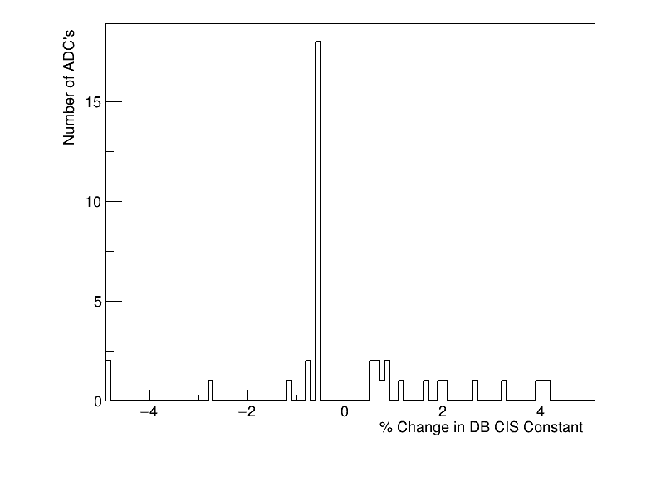
1.b. CIS Constant Update:
October 1 - November 1
CIS runs from October 1 - November 1
40 channels in update
21 Good (>1 successful calibration)
8 Masked
11 Affected
2 >5% change
Runs excluded (1+TestRuns): 436189
Runs used (9): 435886 436536 436813 436852 437309 437563 437792 438209 438370

Slide 5
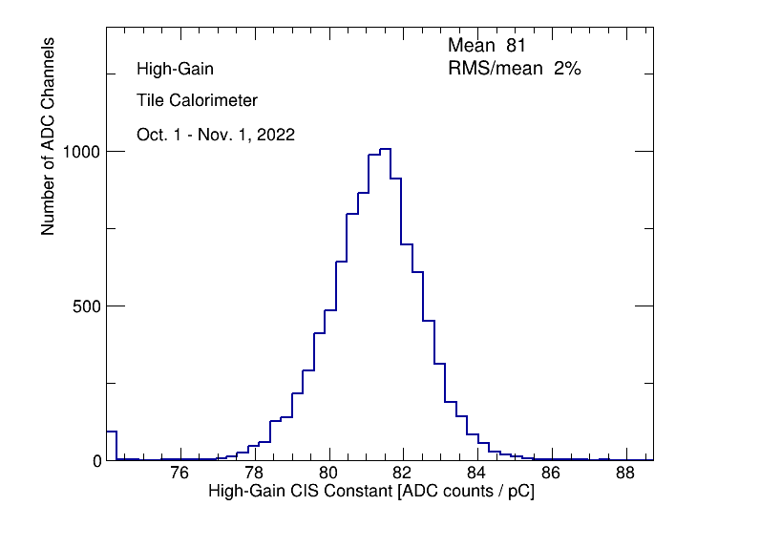
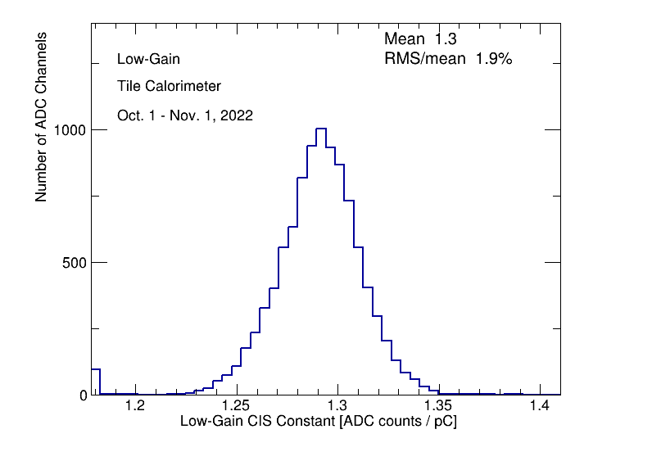
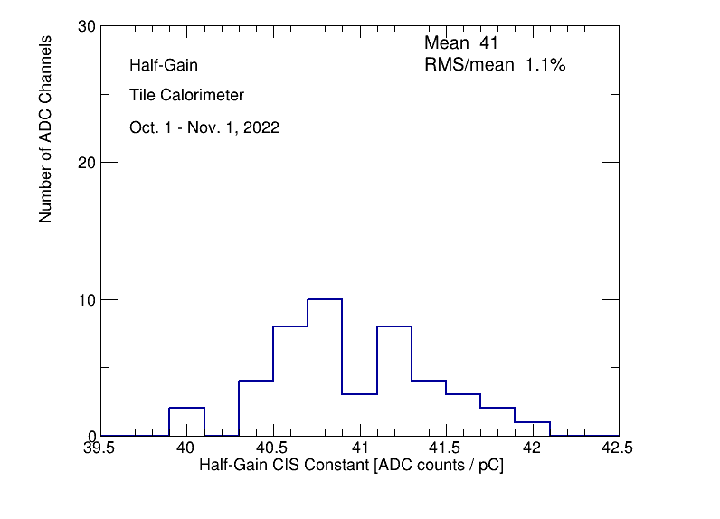
1.b. CIS Constant Distributions:
October 1 - November 1
These overflows come from LBA 28, 63. They were masked near the end of October, so CIS constant gets calculated as zero for those runs. The value is not updated in the database though.
Demonstrator (LBA14)
Constant Distribution,
now separated from low-gain
High Gain Constant Distribution
Low Gain Constant Distribution

Slide 6
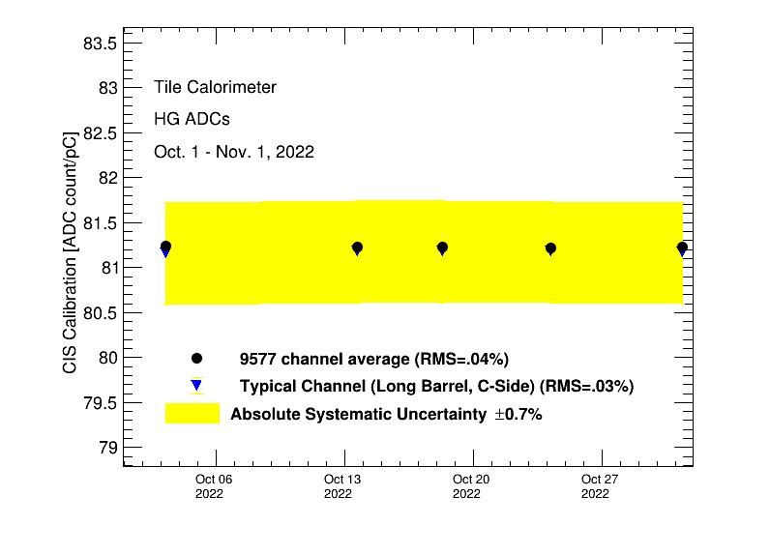
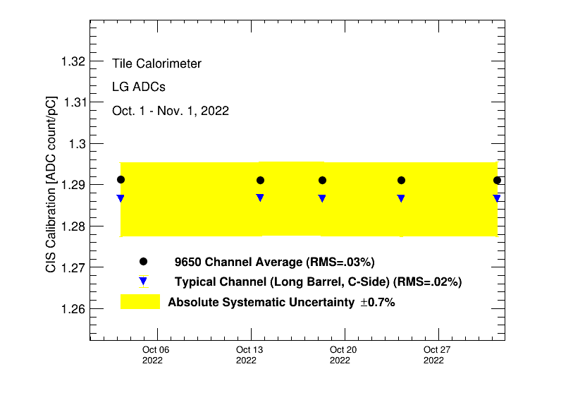
1.b. Detector Time Stability:
October 1 - November 1
CIS Calibration Average in High Gain
CIS Calibration Average in Low Gain

Slide 7
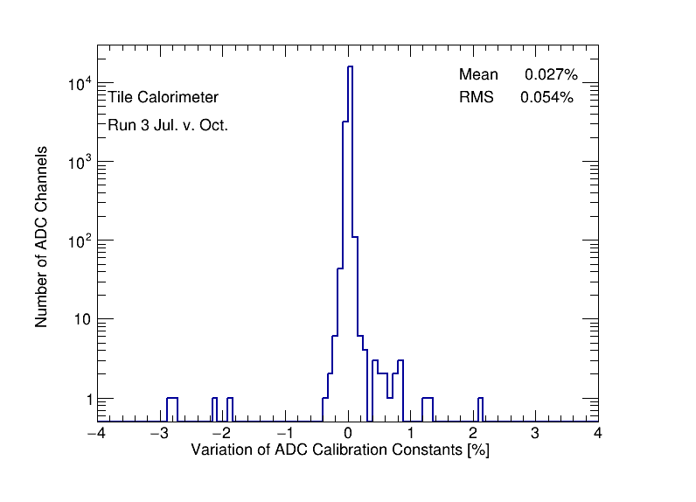
1.b. CIS Constant Long-Term Stability:
October 1 - November 1
Module (with >1% change) | Change (%)
EBC_m30_c11_highgain/lowgain | -2.80/-2.80
LBA_m02_c06_highgain/lowgain | -2.15/-1.87
LBA_m51_c12_highgain | +1.29
LBA_m35_c08_highgain | +1.29
LBC_m57_c06_highgain | +1.28
List of Modules that have at least one CIS constant change larger than 1% and their maximum change rate
Number of Channels vs. Percentage of CIS constant change

Slide 8
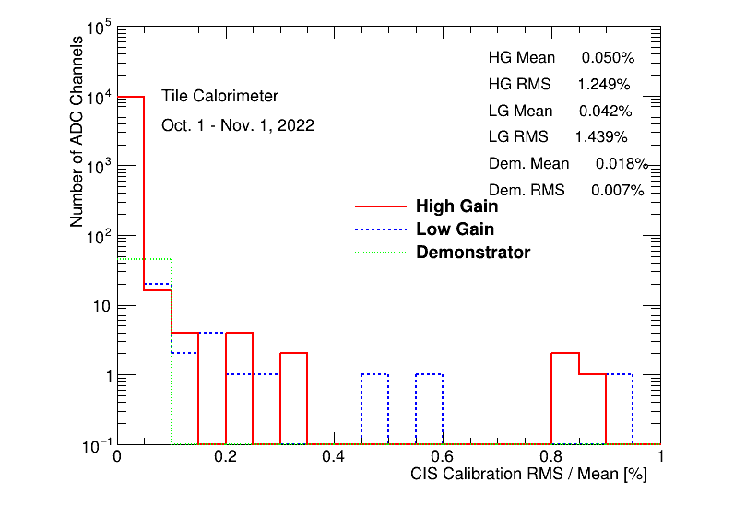
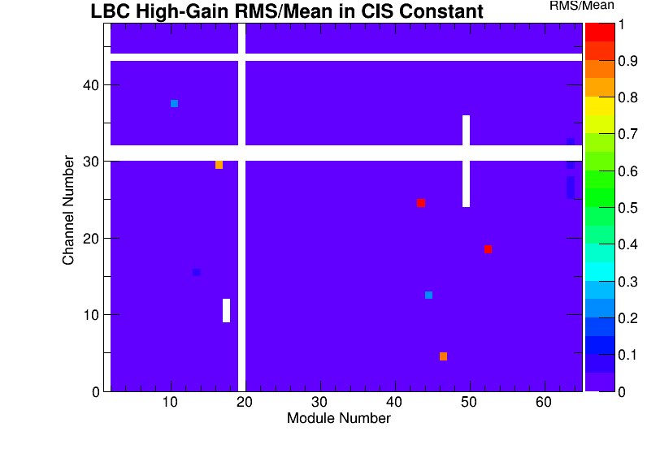
1.b. CIS Constant RMS/Mean:
October 1 - November 1
CIS constant RMS/Mean of High-Gain, Low-Gain and Demonstrator
List of high RMS/mean channels identified
(Note: There is some overflow beyond RMS/mean = 1)

Slide 9
2. End-of-Year Recalibration
Every year, when data taking is over, it's time to prepare CIS constants for reprocessing.
Ideology:
We want to guarantee that we have the best possible CIS constant year round. There may not be one value for the entire run period; there could be multiple different stable values over the course of many months
Any change in the CIS constant by more than 0.5% is detected and stored
During normal monthly CIS calibrations, we assign ONE constant for each channel based on the calibration runs of that month. This updates the future database value for the next month.

Slide 10
2.a. Reprocessing Procedure
Set reference values (First IOV): Using March-April runs, we set a reference value for the CIS constants in all channels using the –-recalALL option
Choose best run_window parameter: From April-November we compare all channels to the First IOV value above and updated if needed with a threshold of 0.5% deviation. To account for shifts in the constants, we try different run_window (10,7,4,3). This parameter dictates the minimum number of runs in each IOV
Final adjustments: Merge all of the .db files after running the above process for each partition. Some channels have more variation, so we may need to set a smaller threshold by hand (~0.1%)

Slide 11
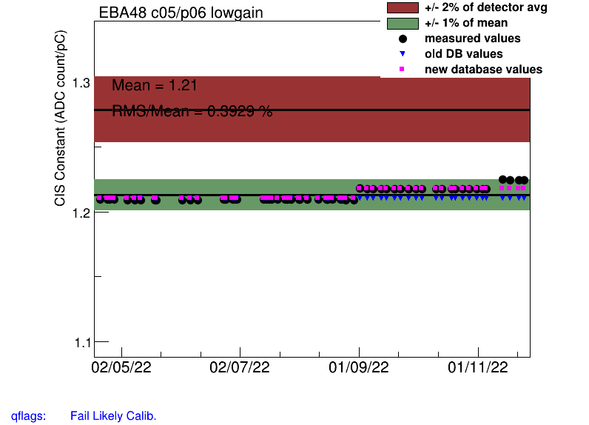
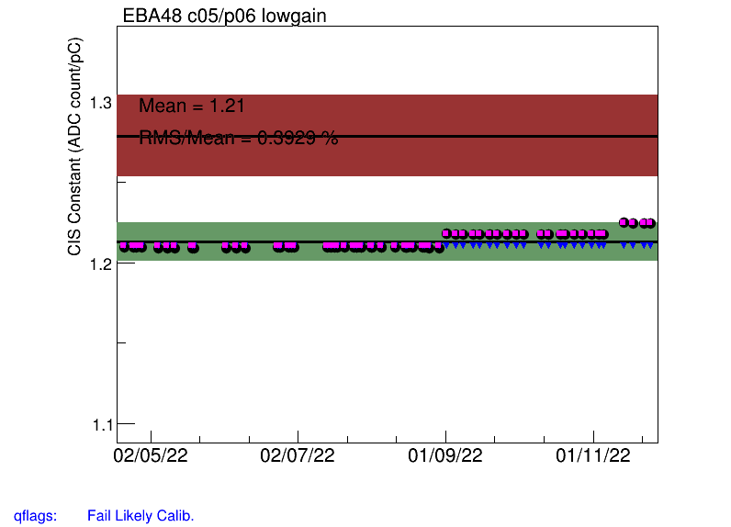
2.a. Multiple IOV Choice
Run Window = 10 (there are periods where the CIS constant has not been at a value for more than 10 runs)
Run Window = 3 (4 was not quite enough to recalibrate the ones at the end of the reprocessing period)

Slide 12
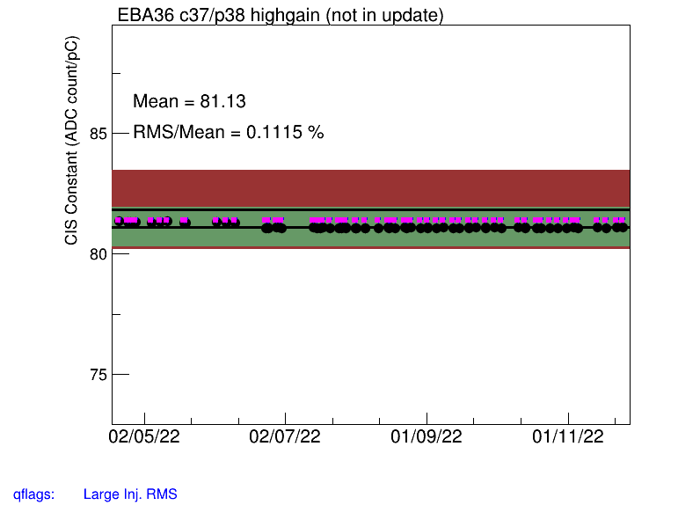
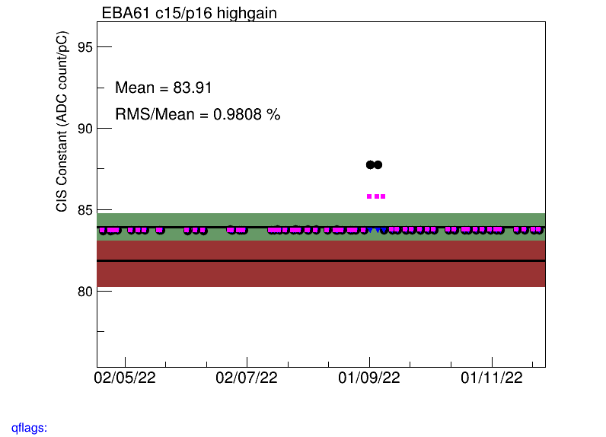
2.a. Common Issues
The update value does not seem to match the value of the calibration runs (deviation less than 0.5%)
Jumps that need to be cross-referenced with the laser calibration system. Do they also see a jump?

Slide 13
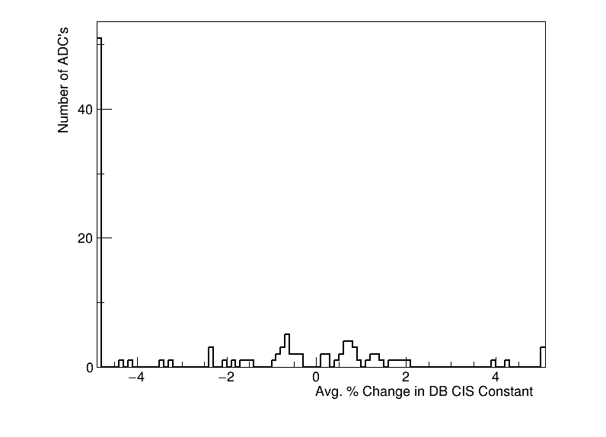
2.b. Result Summary
CIS runs from April 21 - November 28 (to end of Run 3 data taking in 2022)
115 Channels updated (with respect to reference value)
66 Good (>1 successful calibration)
20 Masked
29 Affected
73 >5% change
Plots are preliminary, subject to further improvements
Overflow is due to LBC52 Lowgain channels switched to half gain

Slide 14
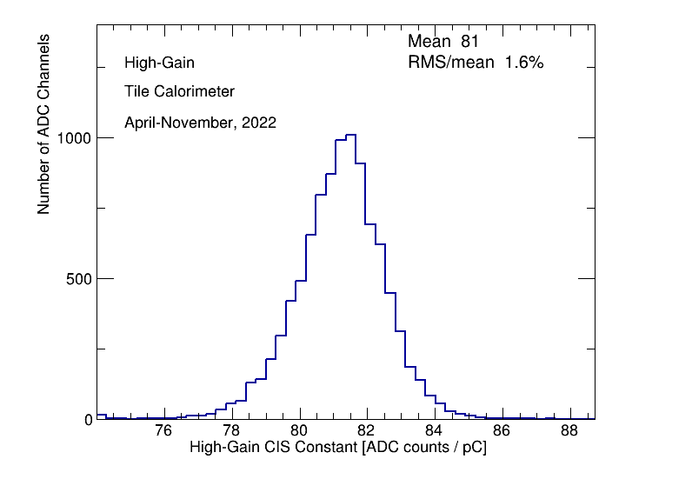
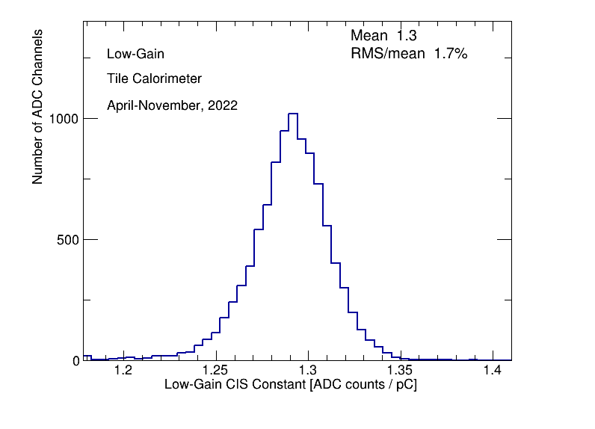
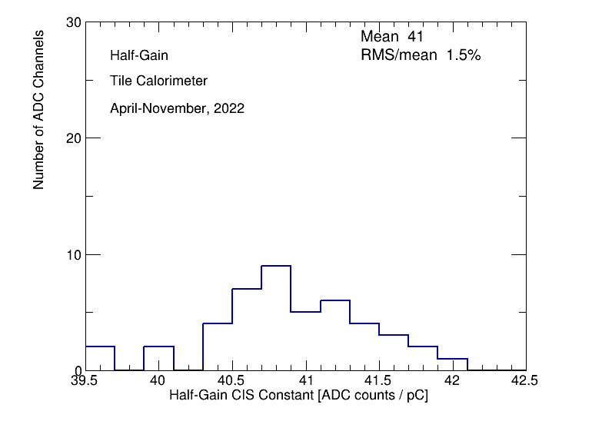
2.b. CIS Constant Distributions
High Gain Constant Distribution
Low Gain Constant Distribution
Demonstrator (LBA14)
Constant Distribution

Slide 15
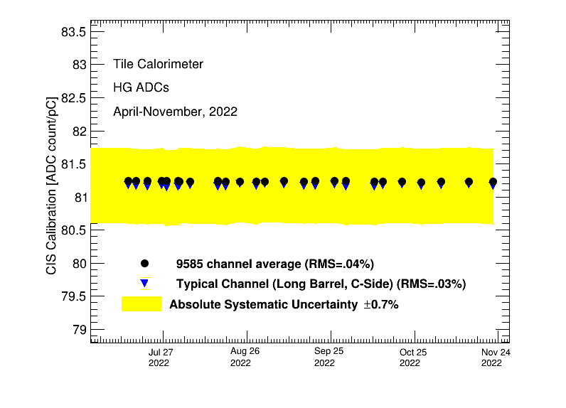
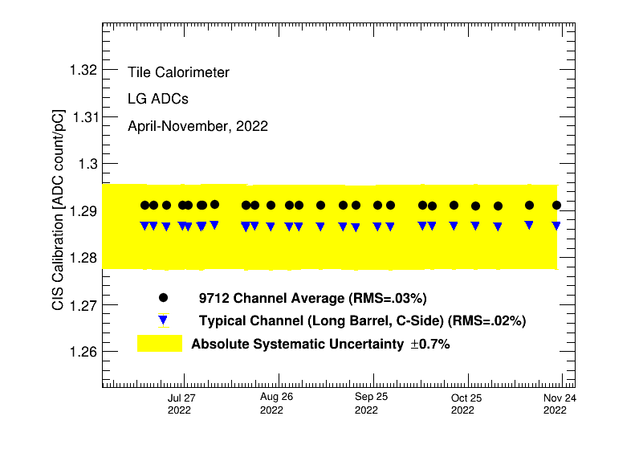
2.b. Detector Time Stability
CIS Calibration Average over Run 3 period in High Gain
CIS Calibration Average over Run 3 period in Low Gain

Slide 16
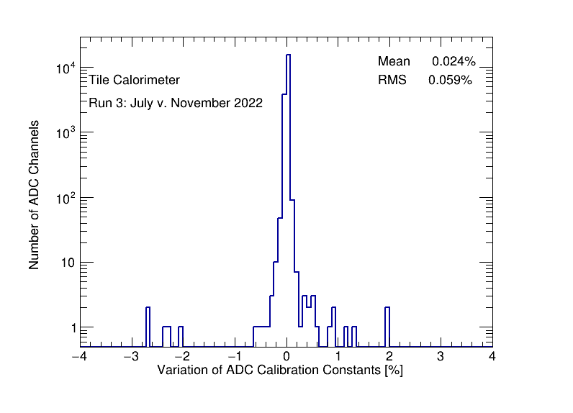
2.b. CIS Constant Long-Term Stability
Module (>1% change) Percent Change
EBC_m30_c11_lowgain -2.672517260729627
EBC_m30_c11_highgain -2.66492136411393
LBA_m02_c06_lowgain -2.3228977296997737
EBA_m49_c00_highgain -2.285064866896219
LBA_m02_c06_highgain -2.0493624322471105
LBA_m51_c12_highgain 1.1879758996524132
LBC_m57_c06_highgain 1.2925450958705886
LBC_m46_c04_highgain 1.9335982057240222
LBA_m35_c08_highgain 1.9759920794871568
List of Modules that have at least one CIS constant change larger than 1% and their maximum change rate, in Run 3 period
Number of Channels vs. Percentage of CIS constant change in Run 3 period

Slide 17
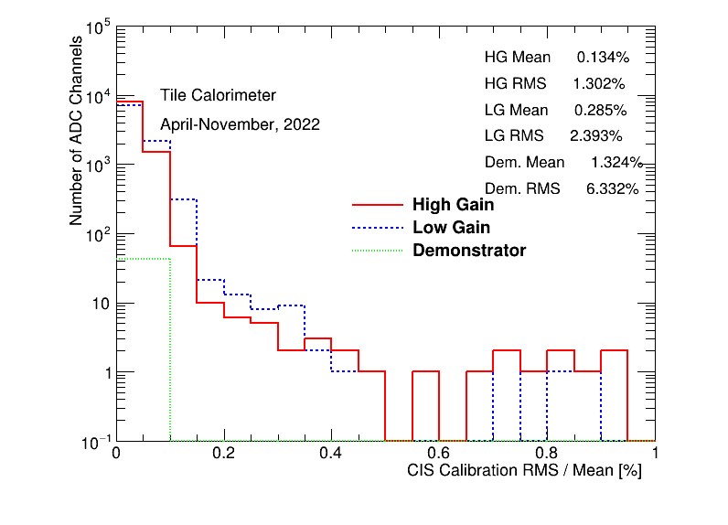
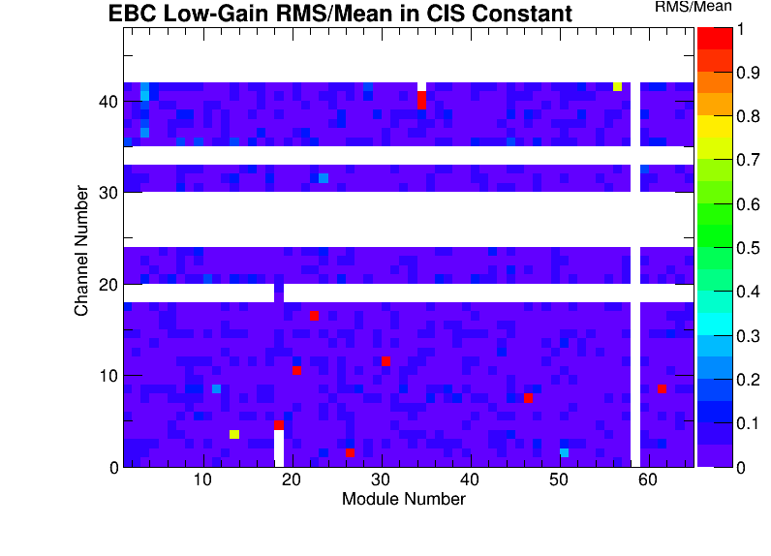
2.b. CIS Constant RMS/Mean
CIS constant RMS/Mean of High-Gain, Low-Gain and Demonstrator
High RMS/mean (>=1) channels identified
(Note: There is some overflow beyond RMS/mean = 1)

Slide 18
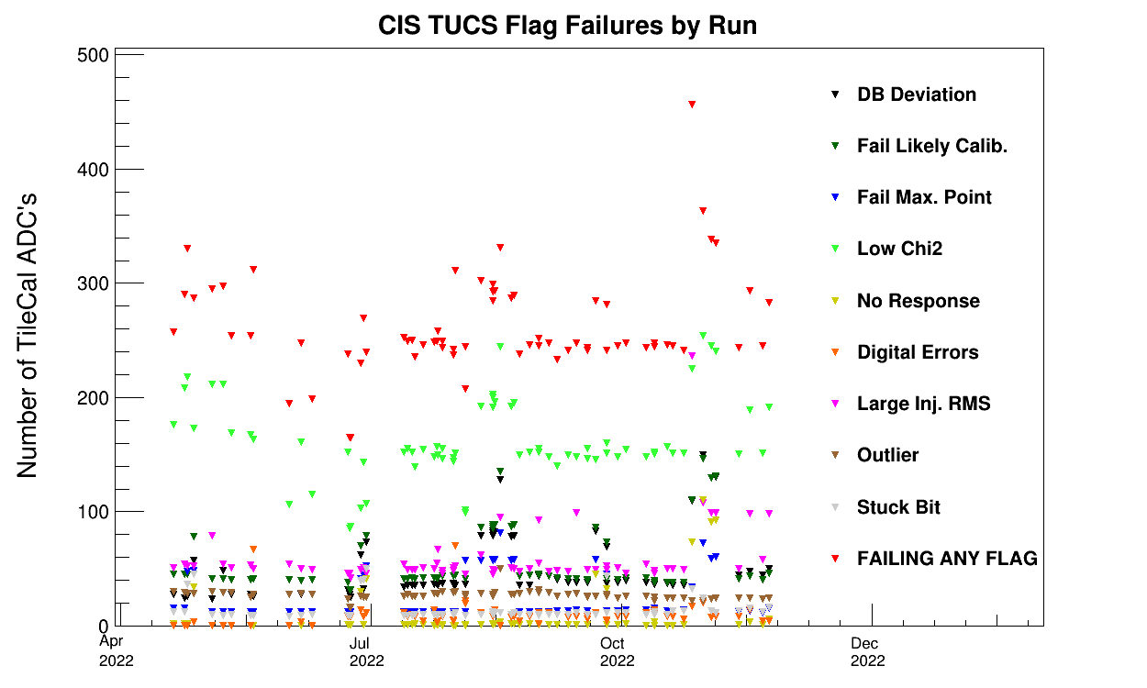
2.b. CIS TUCS Quality Flags
High number of failing flags does not pose a noticeable issue when analyzing the channel-by-channel plots by hand
Number of CIS TUCS Failure Flags by Calibration Runs in RUN 3
Notes:
**** which run is it that has the problems???

Slide 19
3. L1Calo+Tile
We presented a summary of PMT scans and work on Tile+L1Calo operation improvement at the L1Calo+Tile Workshop in November. We’ll present a modified version on Wednesday.
Operational changes:
Now, ERS messages from L1Calo about high rate or noisy towers will include Tile module (not just L1Calo ID). We’re retroactively cataloguing bad towers in 2022 for physics runs by comparing L1Calo map and ERS messages
We moved low rate trigger monitoring histograms from OHP into DQMD so that shifters can check them!
Maintenance:
LBC55: Towers 1-3 were completely dead due to cut wires in the trigger cables probably from insertion of the drawer → Wires have been reconnected!
Future work after maintenance:
Develop histograms to monitor high rate

Slide 20
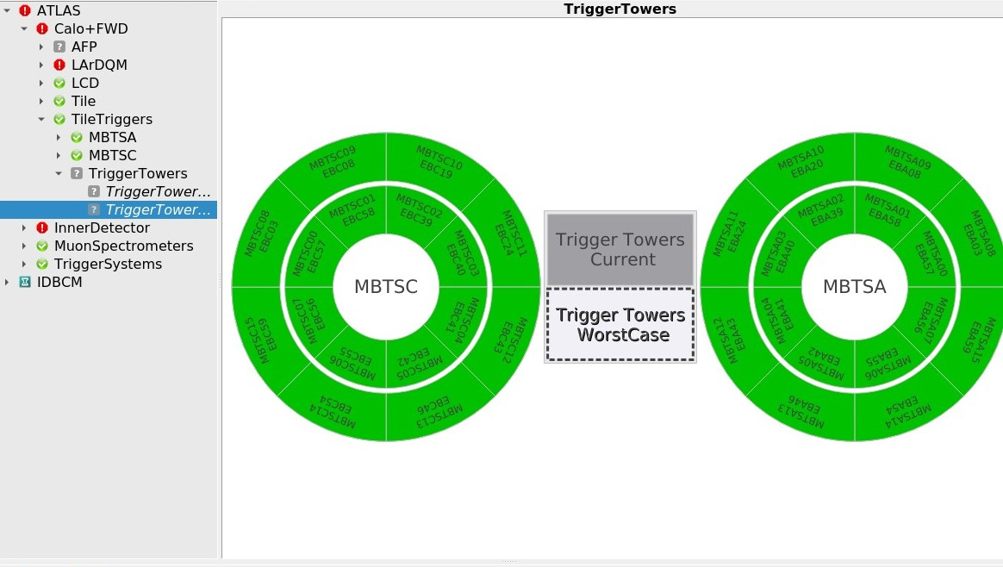
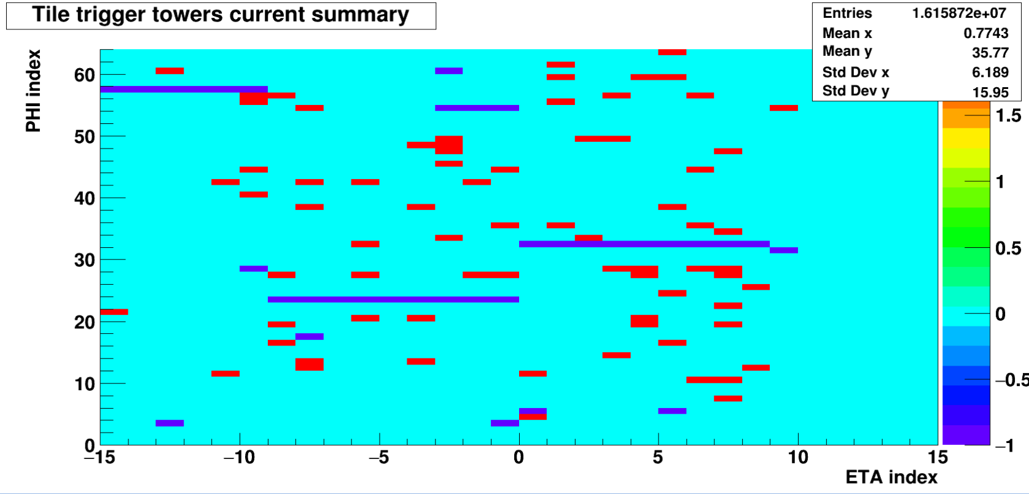
3. L1Calo+Tile
Low rate monitor: -2: no beam -1 : tower not initialized/off 0 :NORMAL state 1: WARNING state 2: LOW RATE state. These values are set according to the following formula:
State = Fast-Smoothed Mean Rate/Reference Mean Rate
⋚
Threshold

Slide 21
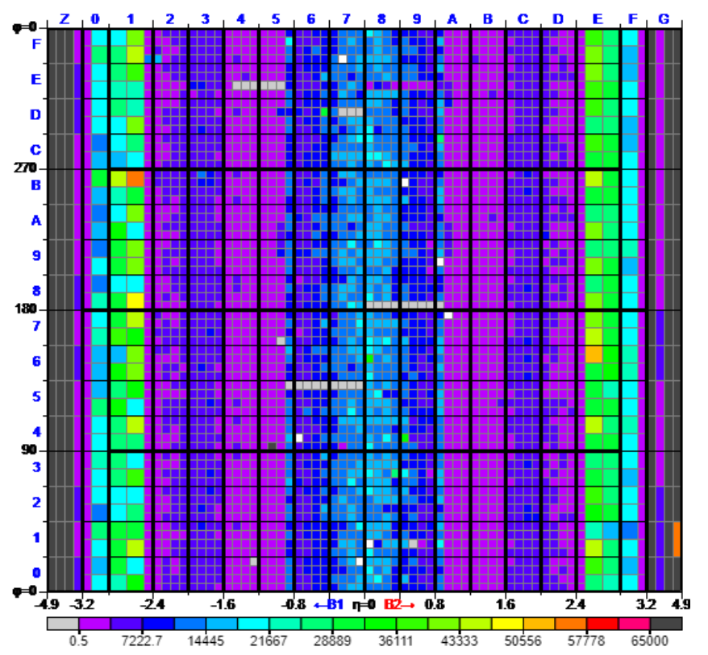
3. L1Calo+Tile
L1 Calo live rate monitor
Each square corresponds to a trigger tower with some L1Calo ID number

Slide 22
4. General Maintenance Status
The Maintenance Period started from (Dec. 8, 2022), and will continue to (Feb. 26, 2023).
EBC will close to run position on Feb. 15, 2023.
EBA will close to run position on Feb. 17, 2023.
(As of Feb 2.) | Identified | Fixed | Scheduled to Fix | Unavailable
EBA | 19 | 7 | 3 | 9
EBC | 18 | 5 | 4 | 9
LBA | 15 | 9 | 1 | 5
LBC | 14 | 7 | 1 | 6
Total | 66 | 28 | 9 | 29
Maintenance General Information

Slide 23
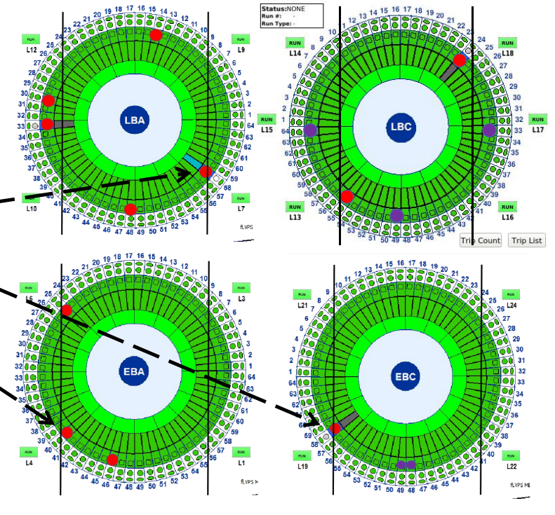
4. General Maintenance Status
Module access varies:
Blocked by scaffolding (sometimes it can be moved)
On top of the muon chambers so there is nowhere to stand
Too far away from the central scaffolding (in this case, balconies can be built)
Sometimes the full drawer cannot be extracted if there is not enough room

Slide 24
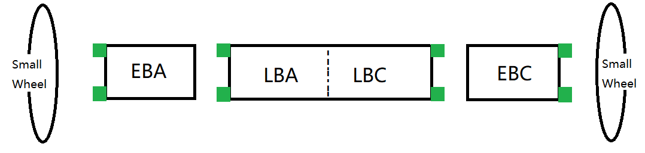
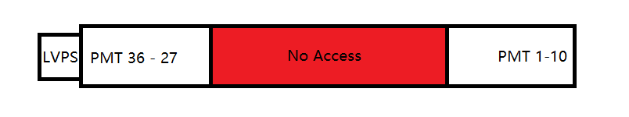
4.b. Maintenance Progress - Electronics
Gap 1.2 m,
not long enough
10 PMT slots

Slide 25
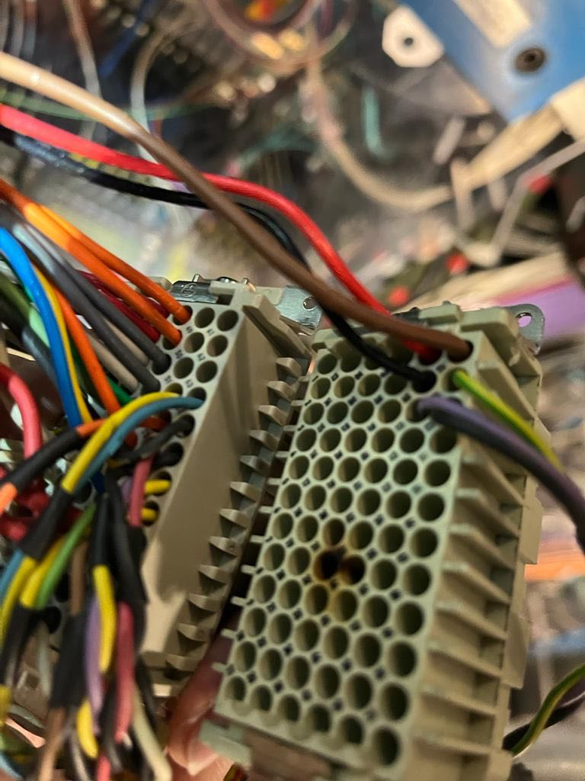
4.b. Maintenance Progress - Electronics
Common problems discovered:
• Damaged Harting connectors to LVPS
• Cut wires (example LBC55 trigger cables)
• Bad 3-in-1 cards in single channels (PMTs)
Solutions employed:
• Crimping and replacing Harting connector and LVPS
• Rewiring and dry soldering
• Replacing 3-in-1 cards
• Diagnosing and testing problems with MobiDick

Slide 26
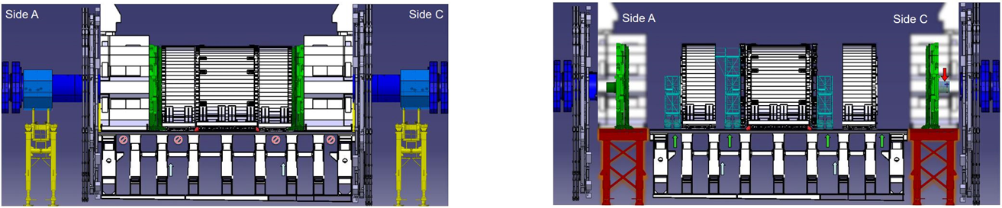

Slide 27
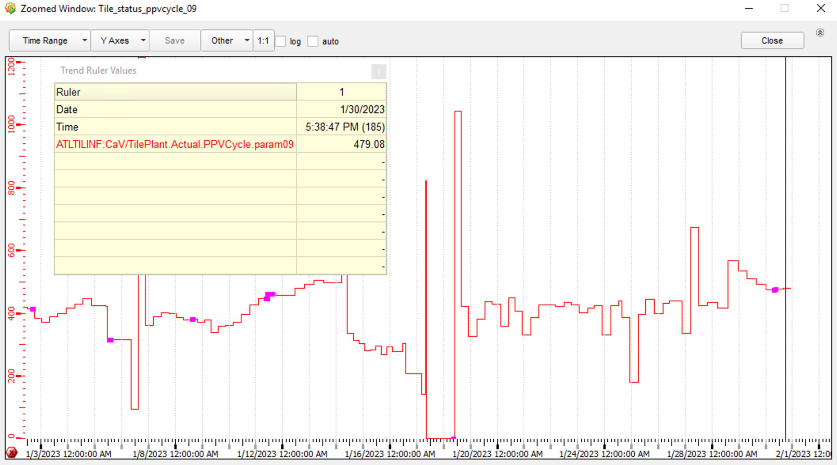
4.c. Maintenance Progress - Cooling
PPV cycle 479 mins as of Jan. 31, 2023, improved from approx. 200 mins.
Common problems discovered:
• Bent hoses on patch panel.
• Leaking connectors.
Solutions employed:
• Unbend hoses.
• Replace connectors (when accessible).
• If leak cannot be identified further than the internal drawer level the offending module loop (4 within each module) is closed.
PPV cycle as of Jan. 30, 2023

Slide 28
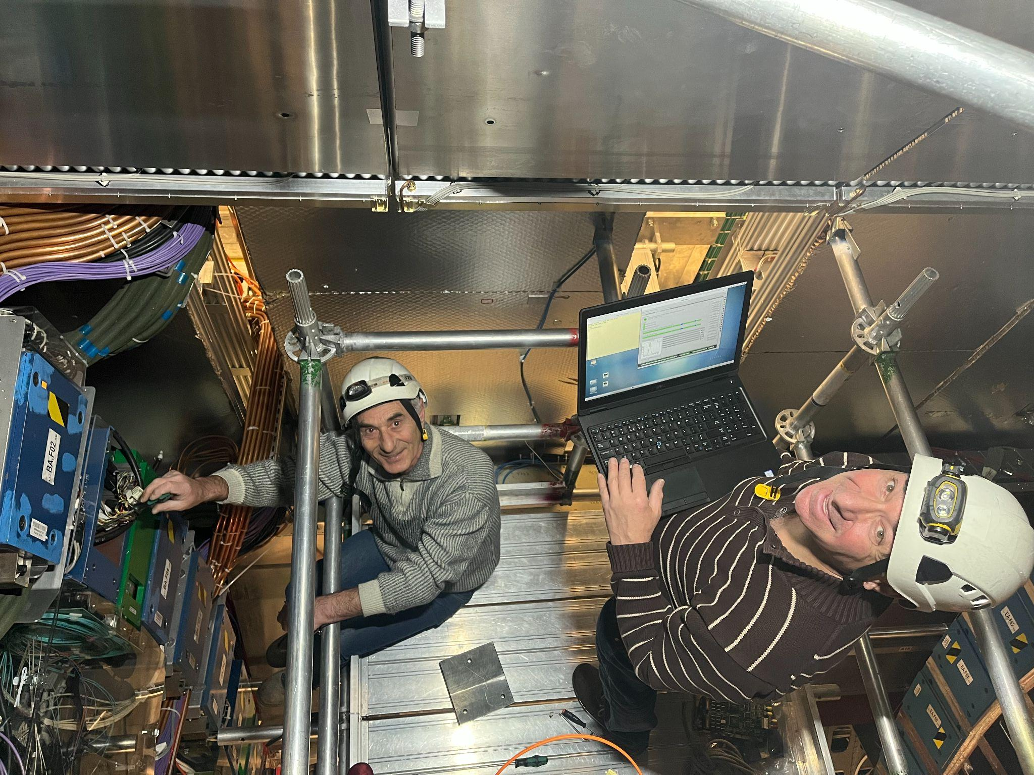
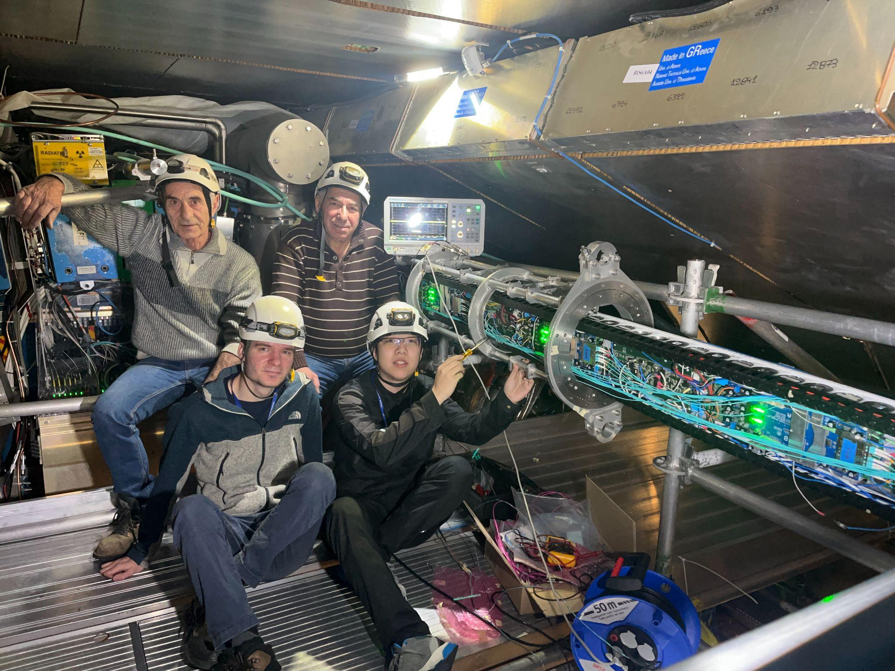
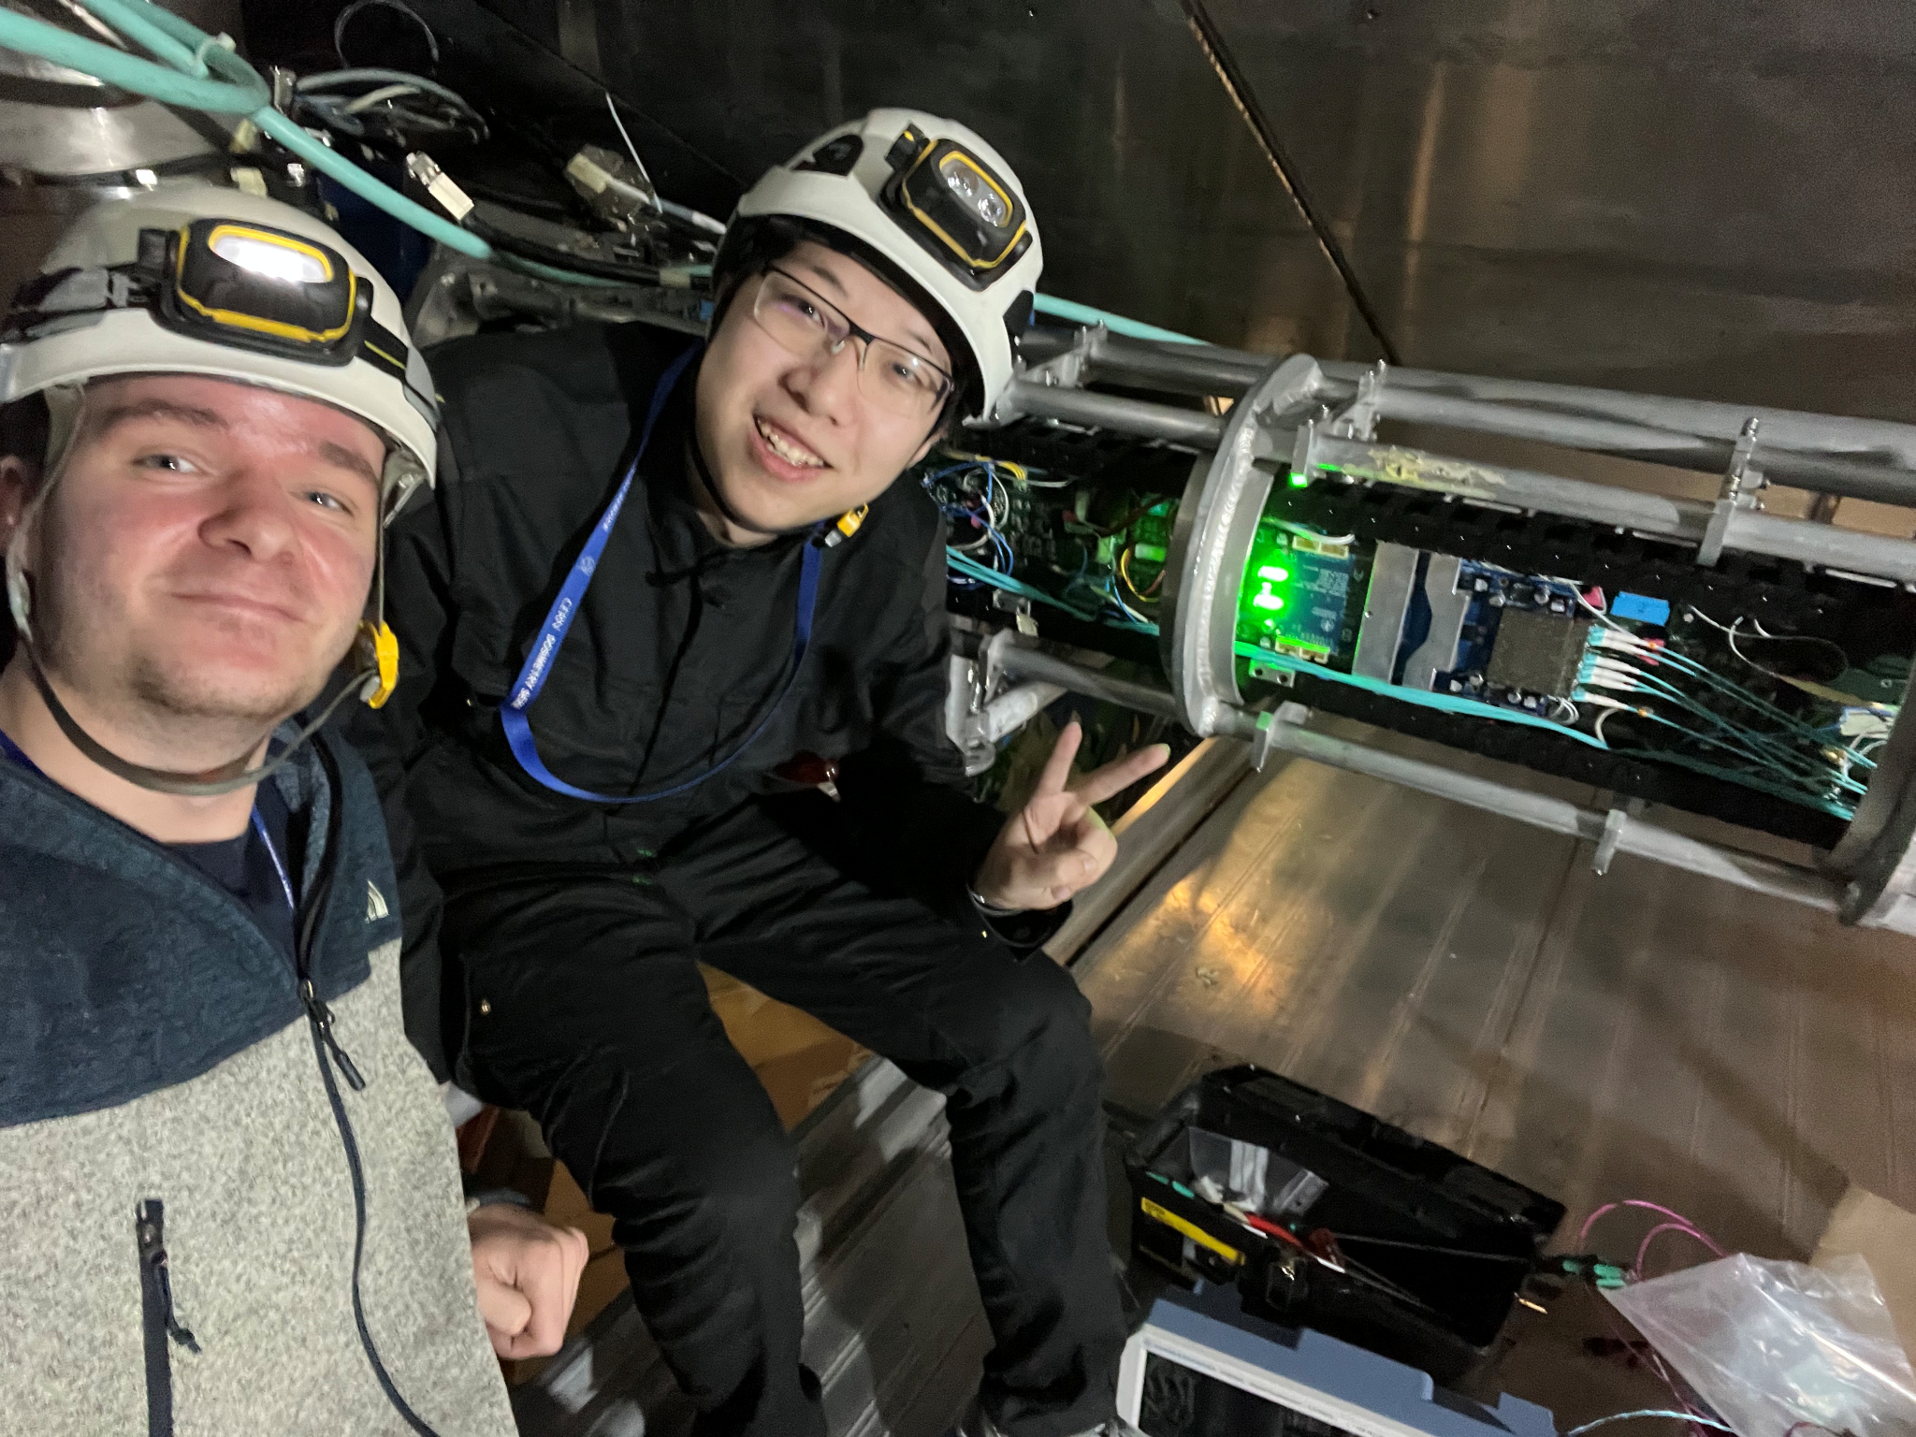
4.d. Maintenance Appendix
Some Maintenance Group Photos of Nugzar, Irakli, Peter and Jacky
Important Links:
List of all problematic modules: Tilecal YETS 2022 - CodiMD (cern.ch) (https://codimd.web.cern.ch/pvIX3mqnS3KdSlV6xV65Mw)
Maintenance Log: ELOG Maintenance (cern.ch) (https://pcata007.cern.ch/elog/Maintenance/page1)
A Morning In The ATLAS Pit - Working On Tiles (https://gopro.com/v/m0gDZPz1PLM8O)

Slide 29
5. Plans For Next Quarter
Presentations:
We will be presenting in Tile Week (Feb. 6-10) on CIS, L1Calo and Maintenance.
We will have a poster session in ATLAS Week (Feb. 13-17) on CIS and L1Calo.
PSI visits:
Jacky will go to PSI Zurich with Seyedali to help some radiation testing on Feb. 8-9.
Chicago main board irradiation tests will be scheduled in March.
Maintenance:
Finish up what’s left in the list in the next two weeks.
We CANNOT recover the radiation monitor because no one is in charge for them.
ATLAS Control Room Shifts
Shifts from March to May have been booked full, we will fill in if needed.
Monthly CIS Constant updates, L1Calo and TUCS works:
Will Resume after Tile Week (Feb. 6-10)
Cancelled Plans:
We gave up on TiO (Tile in One) for now after discussions with Mark and David.

Slide 30
Any Questions?
Summary of Contents:
Normal CIS Constant Updates
End-of-Year Recalibration/Reprocessing
L1Calo PMT Scans
Maintenance Progress
Plans for Next Quarter

Slide 31
Thank you for your attention ☺

